Slide 1
Dataset
Phase I – Data Pre-Processing
Oversampling
Feature Engineering
Handling Missing Values
Encoding
Copies of the minority class
Train
Test
Phase II – Classification Model
Performance Evaluation

Slide 2
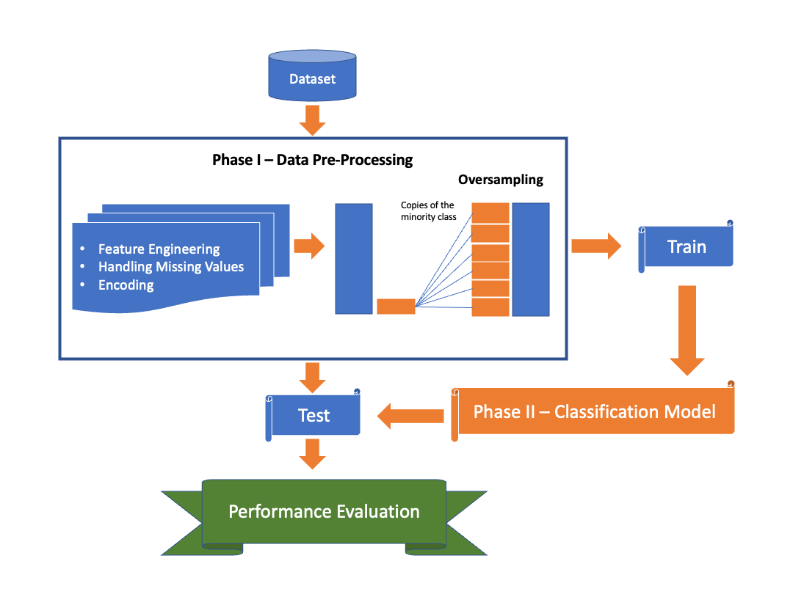
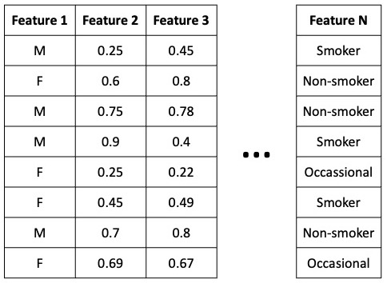
Encoding Categorical Variables
N distinct copies of Encoded Dataset created
Various Encoding Methods
Leave-Out-One Encoded Categorical Features
LOOE
One-Hot Encoded Categorical Features
One-Hot
Cat-Boost Encoded Categorical Features
CBE
Weight of Evidence Encoded Categorical Features
WOE
Label Encoded Categorical Features
Label
…
…
Target
Target Encoded Categorical Features

Slide 3
Feature 1 | Feature 2 | Feature 3
M | 0.25 | 0.45
F | 0.6 | 0.8
M | 0.75 | 0.78
M | 0.9 | 0.4
F | 0.25 | 0.22
F | 0.45 | 0.49
M | 0.7 | 0.8
F | 0.69 | 0.67
Feature N
Smoker
Non-smoker
Non-smoker
Smoker
Occassional
Smoker
Non-smoker
Occasional
…

